Slide 1
FOREST MEASUREMENTS (Chapter 11)
Management plans depend on information (e.g., forest cover type, species, size, density, growth rates, location, accessibility, site quality)
Fair prices depend on information (e.g., quantity, quality, size, species)

Slide 2
OUR TOPICS
Scaling
Land surveying & mapping
Timber resource measurements
  Individual trees
  Stands
  Growth & yield / prediction
Nontimber resource measurements

Slide 3
FOREST MEASUREMENTS
Synonyms for this discipline:
  Forest mensuration
  Forest biometrics
Goals: efficient measurement of
  Existing forest resources
  Resource growth (change)
  Resource response to management practices

Slide 4
WOOD PRODUCTS
PRIMARY wood products (raw materials)
  Sawlogs (at least 8 feet long)
  Bolts (short logs)
  Chips
SECONDARY (i.e. manufactured) wood products, e.g.:
  Paper
  Plywood
  Furniture

Slide 5
MEASUREMENT OF PRIMARY PRODUCTS
SCALING ≡ measuring the quantity of primary wood products (see Fig. 11.1)

Slide 6
SCALING: SAWLOGS AND BOLTS
Units of Measure:
  Board foot: a plank 1’ x 1’ x 1”
  Standard cord: 4’ x 4’ x 8’ stacked wood
    128 ft³ wood, air, and bark
    Corresponds to ~ 64-96 ft³ solid wood
  Variations on standard cord (see Fig. 11.2)
    Short cord: 4’ x 8’ x less than 4’ (e.g., 1’ firewood)
    Split face cord

Slide 7
SCALING: SAWLOGS AND BOLTS (continued)
How to estimate board foot volume of log?
  Measure something and apply “log rules”
  Log rules should account for
    Log taper
    Waste in sawmill
      Saw kerf (sawdust)
      Slabs (round edges of logs)
Saw Cuts (⇒ kerf)

Slide 8
SCALING: SAWLOGS AND BOLTS (continued)
International Log Rule
  Allows for log taper
    Thus, more accurate than Doyle & Scribner rules
    1/2” diameter taper assumed per 4’ log section
  V = 0.22D² - 0.71D (for 4’ log section)
  V = volume (board feet)
  D = log’s small end diameter inside bark, inches

Slide 9
SCALING: SAWLOGS AND BOLTS (continued)
Log rules ⇒ gross scale
NET SCALE = gross scale - scale defects
  Scale defects are, e.g.:
    Rot
    Wormholes
    Ring separation
    Splits
    Sweep & crook (lack of log straightness)

Slide 10
SAWLOG GRADING
Defects reduce value and limit use
  Knots
  Spiral grain
  Stain
Grading rules focus on clear lumber
MRI used in future sawmills?

Slide 11
SCALING FOR PULP AND PAPER
Pulpwood & chips are scaled by weight
  Full truck weighed before unloading
  Truck weighed after unloading (tare)
  Difference = primary product weight

Slide 12
LAND SURVEYING & MAPPING
Used in forestry to, e.g.:
  Locate property & stand boundaries
  Measure land areas
  Locate roads, streams, etc.
  Locate sample plots for resource measurements

Slide 13
LAND SURVEYING & MAPPING
Units
  Distance: feet, chains, miles
    1 chain = 66 feet
    1 mile = 80 chains = 5,280 feet
  Area: acres, square miles
    1 acre = 10 square chains = 43,560 square feet
    1 square mile = 6400 square chains = 640 acres
  N.B. There exist metric units!

Slide 14
LAND SURVEYING & MAPPING
Distance Measurements
  Pacing
    A “pace” is 2 steps
    Accuracy: 1/80 ?
  Chaining
    Uses marked tape
    Accuracy: 1/1000
  Electronic/optical instruments
    Becoming the standard (see Fig. 11.3)

Slide 15
LAND SURVEYING & MAPPING
Direction Measurements
  Magnetic compass
    Measures degrees (0-360) from magnetic north
    BUT maps usually based on true north
    SO must correct for magnetic declination (angle between true north and magnetic north)
  Global Positioning System (GPS)
    Becoming the standard (see Fig. 11.3)

Slide 16
YOUR CHANCE TO MEASURE DISTANCE & DIRECTION!
COMPLETE THE WORKSHEET:
  Individuals: Determine your average number of paces per chain (1 chain = 66 feet)
  Groups:
    Determine distance (in feet) between designated objects by pacing
    Determine compass direction (degrees) from one designated object to another

Slide 17
LAND SURVEYING & MAPPING
Land Surveys
  Metes and Bounds
    Based on physical features (streams, ridges, roads)
    Descriptions often vague
    Physical features can be lost or moved

Slide 18
LAND SURVEYING & MAPPING
Land Surveys
  Rectangular Survey System
    West of Mississippi R. & north of Ohio R.
    Thomas Jefferson’s idea
    “to survey and sell . . . public lands in the Northwest Territory”
  Global Positioning System (GPS)
    Latitude
    Longitude

Slide 19
RECTANGULAR SURVEY SYSTEM (see Fig. 11.4)
Baselines oriented east-west (parallel latitudes)
Principal Meridians oriented north-south
(parallel longitudes)
Townships approx. 6 miles x 6 miles
Township locations are numbered north/south from baselines (“towns”)
Township locations are numbered east/west from principal meridians (“ranges”)

Slide 20
RECTANGULAR SURVEY SYSTEM (see Fig. 11.4)
Townships subdivided into 36 sections (each ~1 square mile)
Sections subdivided into quarter-sections (each is ~160 acres)
Quarter-sections subdivided into ~40-acre parcels (“forties”)
When writing legal description, begin with smallest subdivision

Slide 21
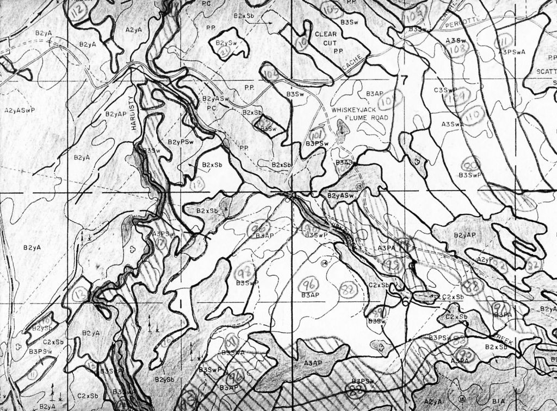
FOREST COVER TYPE MAPS (see Fig. 11.6)
Locations & boundaries of:
  Forest stands
  Nonforested areas (e.g., lakes, roads)
Permit measures of stand area via
  Dot grids
  Polar planimeters
  Digital techniques
Alberta Forest Service, FOR 461, 1977

Slide 22
Alberta Forest Service, FOR 461, 1977

Slide 23
TIMBER RESOURCE MEASUREMENTS
Timber Cruising ≡ forest stand sampling to estimate wood quantity & quality (Fig. 11.8)
Requires data collection from individual sample trees, e.g.:
  Diameter
  Height
  Species
  Age

Slide 24
TIMBER RESOURCE MEASUREMENTS
Individual Tree Diameter
  dbh (diameter at breast height) ≡ diameter, outside bark, 4.5 feet above ground, uphill side of tree
  Measured by, e.g.:
    Calipers (see Fig. 11.7)
    Diameter tape (d-tape)
    Biltmore stick
    Electronic devices

Slide 25
TIMBER RESOURCE MEASUREMENTS
Individual Tree Basal Area
  First measure dbh in inches; then:
    Basal area in square feet: b = 0.005454 dbh²
    Can be extended to stand basal area (square feet per acre): a measure of stand density, crowding

Slide 26
TIMBER RESOURCE MEASUREMENTS
Individual Tree Height, measured by:
  Height poles
    Accurate (when feasible to use)
    Impractical in most cases
  Hypsometers (see Figs. 11.9, 11.10)
    Haga altimeter
    Suunto clinometer
    Abney level
    Electronic devices

Slide 27
TIMBER
RESOURCE
MEASUREMENTS
To measure tree height with hypsometer:
  Must be known distance from tree (remember pacing?)
  Measure angles from horizontal to:
    Top of tree
    Bottom of tree
  Then: use geometry/trigonometry to determine height (hypsometer does some or all of this)

Slide 28
TIMBER RESOURCE MEASUREMENTS
Individual Tree Volume & Mass
  Determined from dbh (basal area) & height
  Tables available, based on geometric formulas

Slide 29
TIMBER RESOURCE MEASUREMENTS
Age
  Measured with increment borer (see Fig. 11.13)
    Extract core of wood (at breast height)
    Count rings (allow for time to grow to breast height)
  Radial increment (each ring’s width)
    Provides estimate of diameter increment per year
    Enables analyses of growth rate changes over time

Slide 30
TIMBER RESOURCE MEASUREMENTS
How to estimate timber volume in a STAND?
  1. Sample a representative set of trees
  2. Collect appropriate data from sampled trees
  3. Calculate estimates of total stand volume

Slide 31
TIMBER RESOURCE MEASUREMENTS
Sampling may use:
  Sample plots of defined size (see Fig. 11.14)
  OR
  Horizontal point sampling (see Figs. 11.15, 11.16)
    MUCH faster method
    Plot has area proportional to basal area of the tree
      Large-dbh trees tallied on large plots
      Smaller-dbh trees tallied on smaller plots
    More precise estimates (large-dbh trees contribute more to stand basal area)

Slide 32
TIMBER RESOURCE MEASUREMENTS
Sampling Issues
  Sample size depends on
    Precision desired
    Variability in the resource
  Sampling methods (see Fig. 11.17)
    Random sampling
      Sample plot location is completely random
      Good statistical properties
    Systematic sampling (line-plot cruising)
      Easier to implement than random
      Much faster in the field than random

Slide 33
TIMBER MEASUREMENTS:
Stand and Stock Tables (Table 11.5)
Show trees & volume per stand for each:
  dbh class
  Species
  Tree or log grade
Derived from:
  Timber cruise data
  Stand areas (from forest cover type maps)

Slide 34
TIMBER MEASUREMENTS: Growth and Yield Estimates (Table 11.6)
The following volumes are measured in repeated surveys (in permanent sample plots):
  Ingrowth: volume of new trees in plots
  Survivor growth: volume growth of surviving trees since last measurement
  Mortality: volume of trees dying since last measurement
  Cut: volume of trees harvested during period

Slide 35
TIMBER MEASUREMENTS: Site Index (Fig. 11.20)
SI ≡ average height of canopy trees at a specified index age
  Index age often 50 years, BUT . . .
  Index age varies among locations and species, e.g., often 100 years in West
SI related to factors affecting growth (e.g., soil quality, available water, topography)
SI may be predictable from such factors

Slide 36
TIMBER RESOURCE MEASUREMENTS
Future growth and yield may be predicted from
  Previous growth & yield data
  Site Index
Growth and yield predictions are essential for management decisions

Slide 37
NOW IT’S YOUR TURN TO CRUISE TIMBER!
COMPLETE MEASUREMENTS WORKSHEET:
  1. Locate sample plot assigned to your group
  2. Determine which trees are in your plot
  3. Measure dbh and height of each tree in plot
  4. Complete and submit worksheet

Slide 38
Team Assignments to Plots
TEAM | PLOT
 | #1: 147 feet @ 254 degrees
 | #1: 147 feet @ 254 degrees
 | #2: 159 feet @ 247 degrees
 | #2: 159 feet @ 247 degrees

Slide 39
NONTIMBER RESOURCE MEASUREMENTS
Water
  Quantity
  Quality
  Timing
Wildlife & Fish
  Population sizes
  Habitat quality
  Habitat quantity

Slide 40
NONTIMBER RESOURCE MEASUREMENTS
Recreation
  Users:
    Numbers
    Impacts
    Attitudes
  Site:
    Quantity
    Quality

Slide 41
NONTIMBER RESOURCE MEASUREMENTS
Range
  Quantity
  Quality
  Periodic productivity
Urban Forests (complete census OR sample)
  Species
  Size & condition (health)
  Location & ownership

